Slide 1
Regeneration in the caudal fin of Zebrafish
Alaina Doran

Slide 2
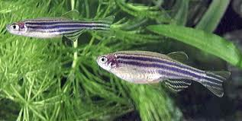
Introduction
Zebrafish (Danio rerio)
Tropical freshwater fish belonging to the minnow family
In late 2003, transgenic zebrafish that express green, red, and yellow fluorescent proteins became commercially available in the U.S. and are now commonly found in aquariums.
Zebrafish are one of the few fish species to have been sent into space.

Slide 3
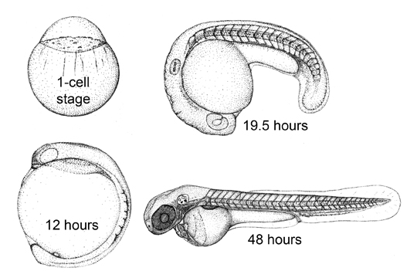
Model Organism
Short generation time
Ability to raise and maintain large numbers in the lab
Complete sequenced genome
Expanding amount of Zebrafish embryologists.
(http://www.umassmed.edu/zebrafish/model.aspx)

Slide 4
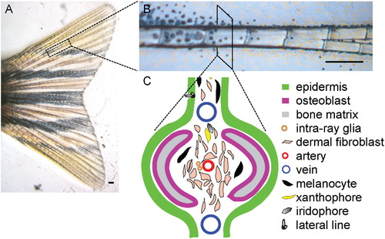
Study of regeneration in the caudal fin
Develops over a short period of time.
Re-grows rapidly after amputation.
Ease of access.
Regeneration is thought to be largely controlled by the fin ray.
Rays are composed of bony segments.
Rays grow proximal to distal by addition of segments.

Slide 5
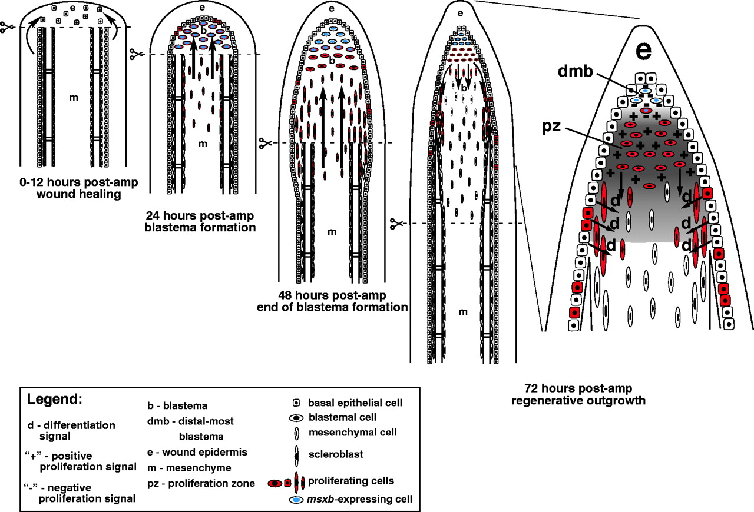
Mechanism of Regeneration
Wound Healing.
  Cell migration
Blastema formation.
  Proliferative mass of mesenchymal cells give rise to new structure of the fin (msxb).
Regenerative outgrowth.
  After 4 days of post amputation the ray consists of a mature blastema and differentiating cells (Fgf).

Slide 6
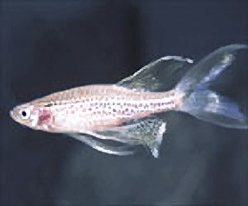
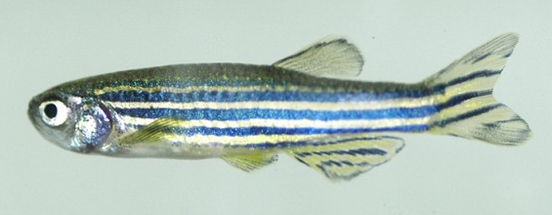
Normal Fin Growth
Wild-Type
Mutant long-fin
Body and fins of wild-type Zebrafish retain proportionality as juveniles and adults (Iovine et al. 2000).
Utilize isometric growth throughout their lifetime (Iovine et al. 2000).
Isometric growth abolished.
Zebrafish have increasing longer fins with respect to body.

Slide 7
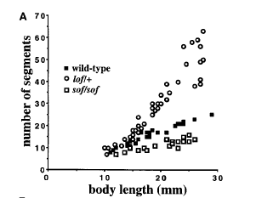
Normal Fin Growth
Researchers believe the mutation bypass normal growth control mechanisms or growth checkpoints.
Two mechanisms
  Size
  Number
(Iovine et al. 2000)

Slide 8
Fin regeneration
Researchers believe that wild-type have a target fin size.
Mutant long-fins bypass target size.
When the mutant fin is amputated the fin does not regenerate to its original size but regenerates a fin that is proportional to its body. (Iovine et al. 2000).
Hypothesis
The wild-type zebrafish will regenerate back to the original length and the mutant long-fin will regenerate to a fin that is proportional to its body.

Slide 9
Methods
5 short fin
5 long fin
A vertical cut was made with a razor blade down the caudal fin.
The fish were anesthetized with tricaine before the cuts.
The fish were placed back in there tanks and photos were taken of the caudal fin once a week for the next three weeks.

Slide 10
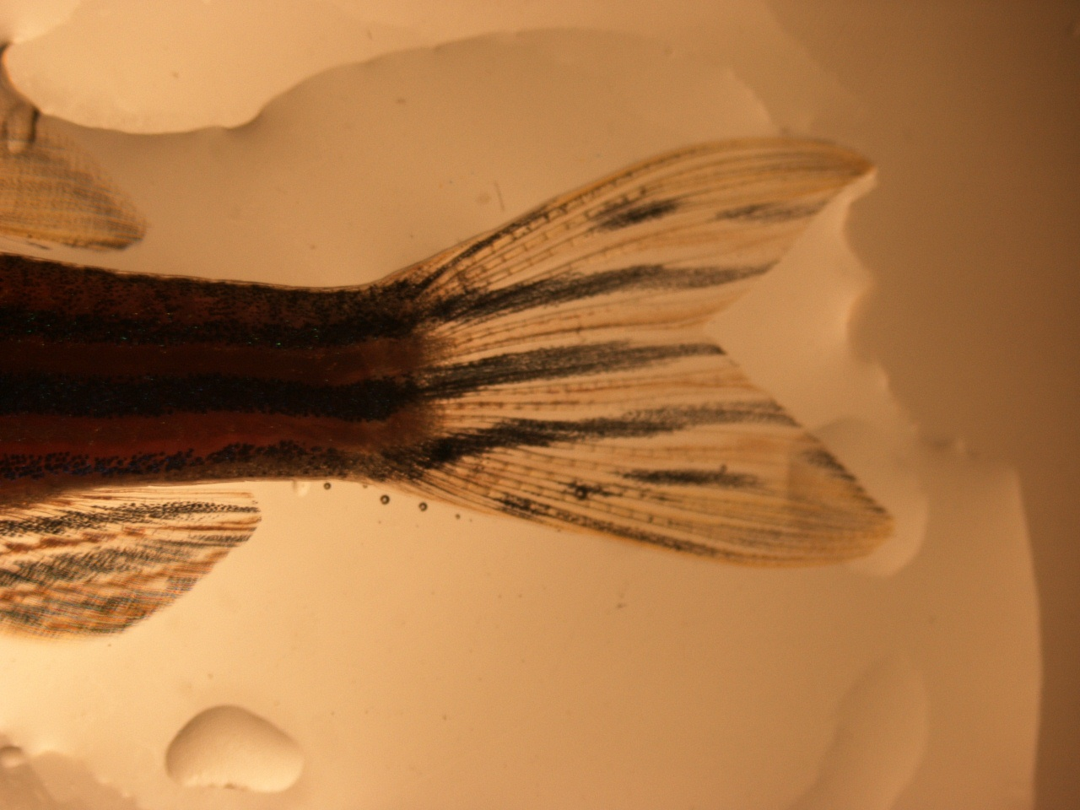
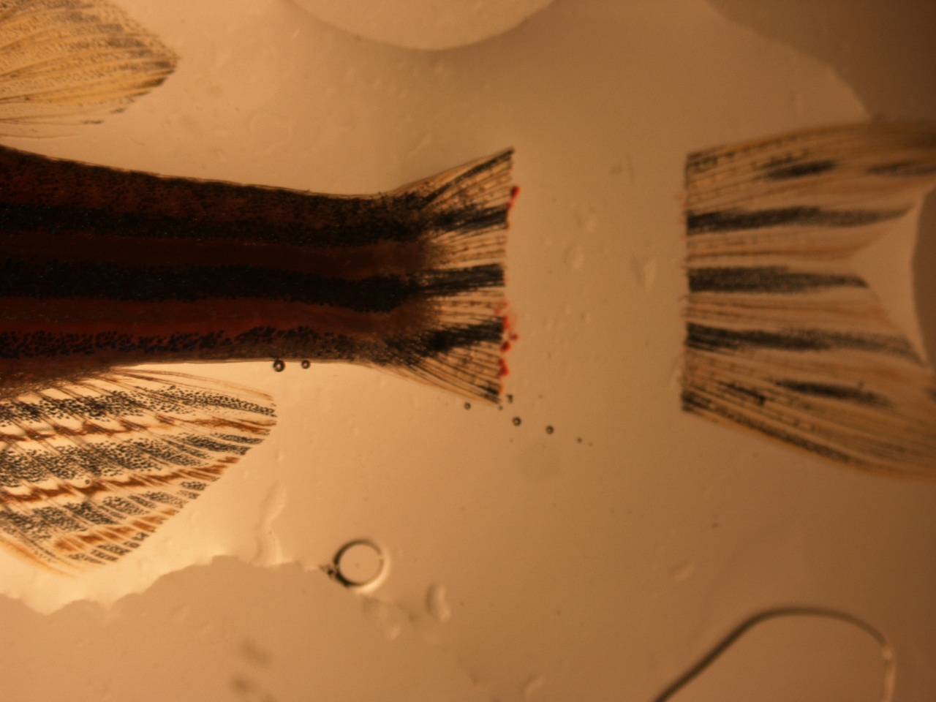
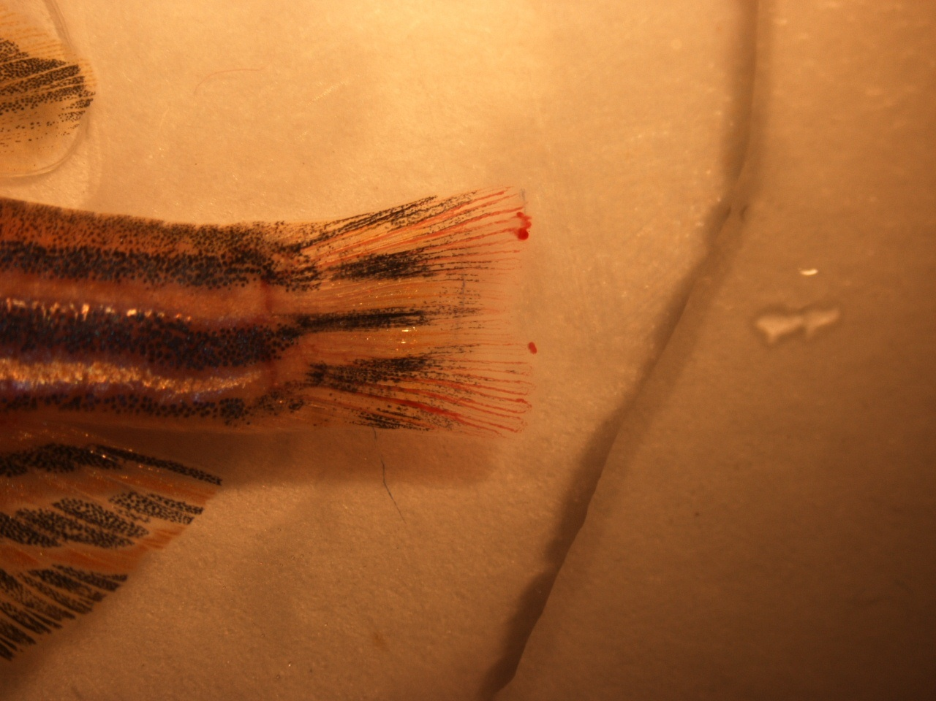
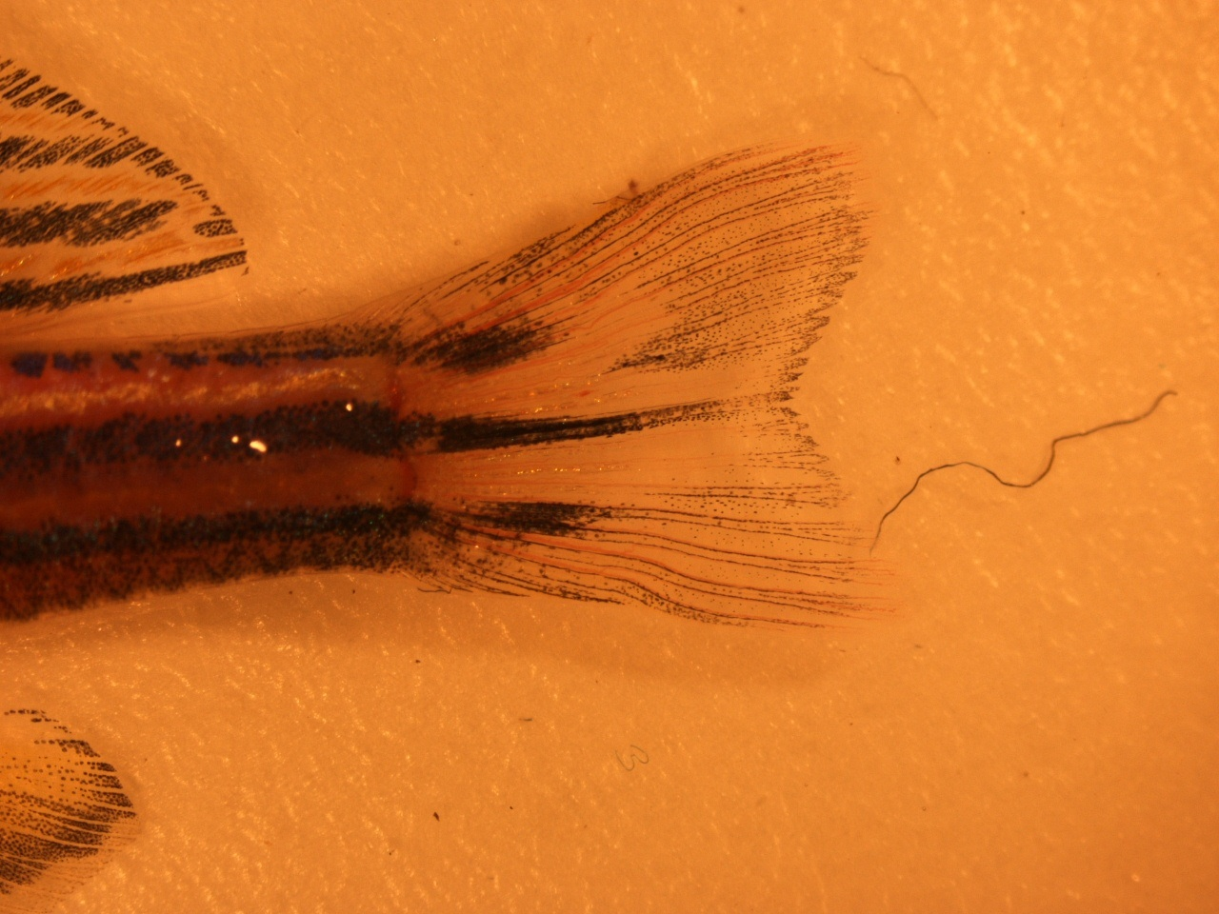
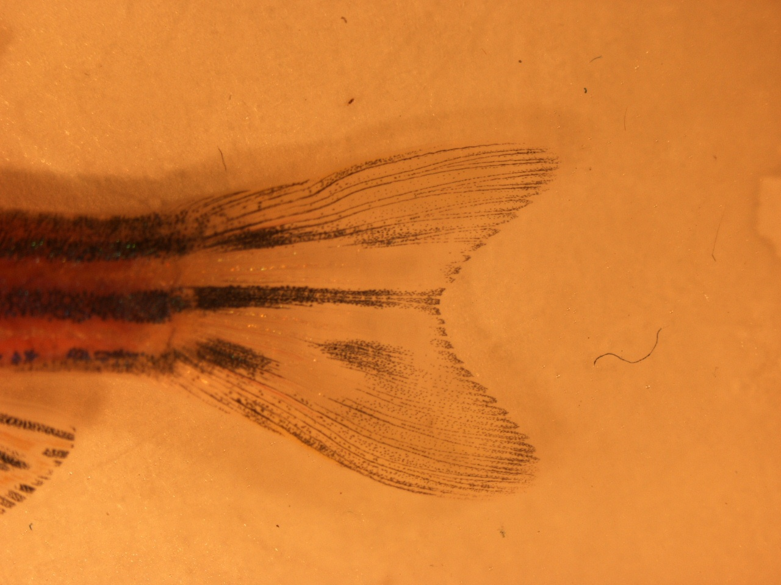
Results Wild-Type
A B C
D E
Figure 1- (A-B) the caudal fin of an adult Zebrafish before and right after the cut was made. C is seven days after the cut, B is 14 days after the cut, and E is 21 days after the cut.

Slide 11
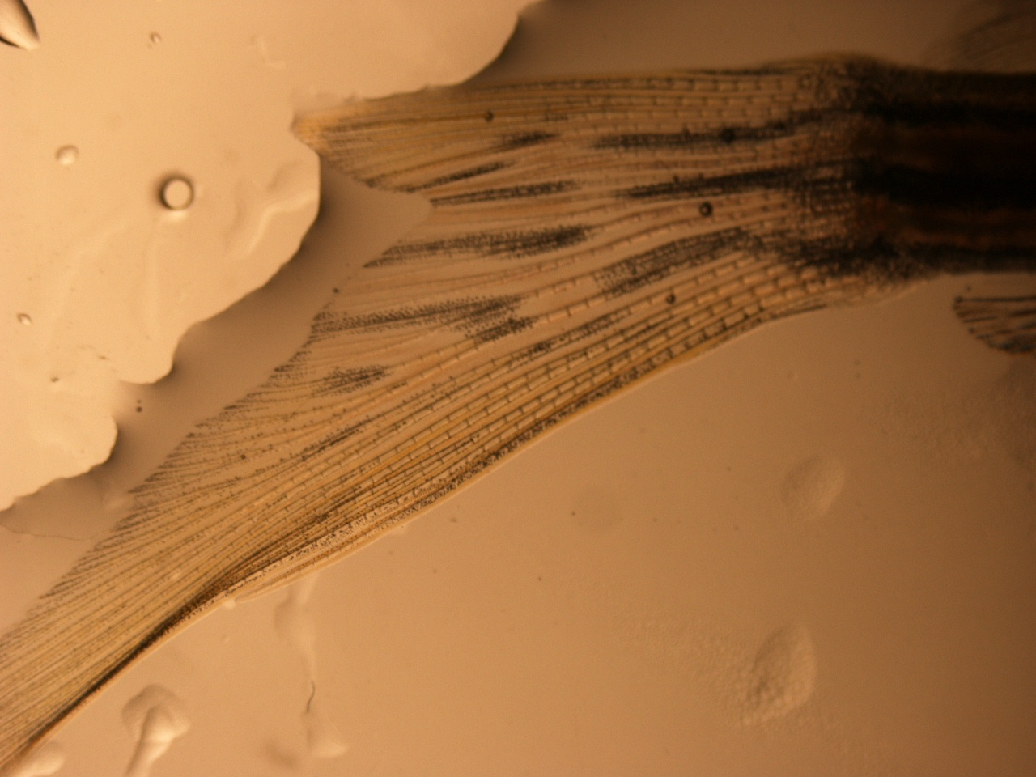
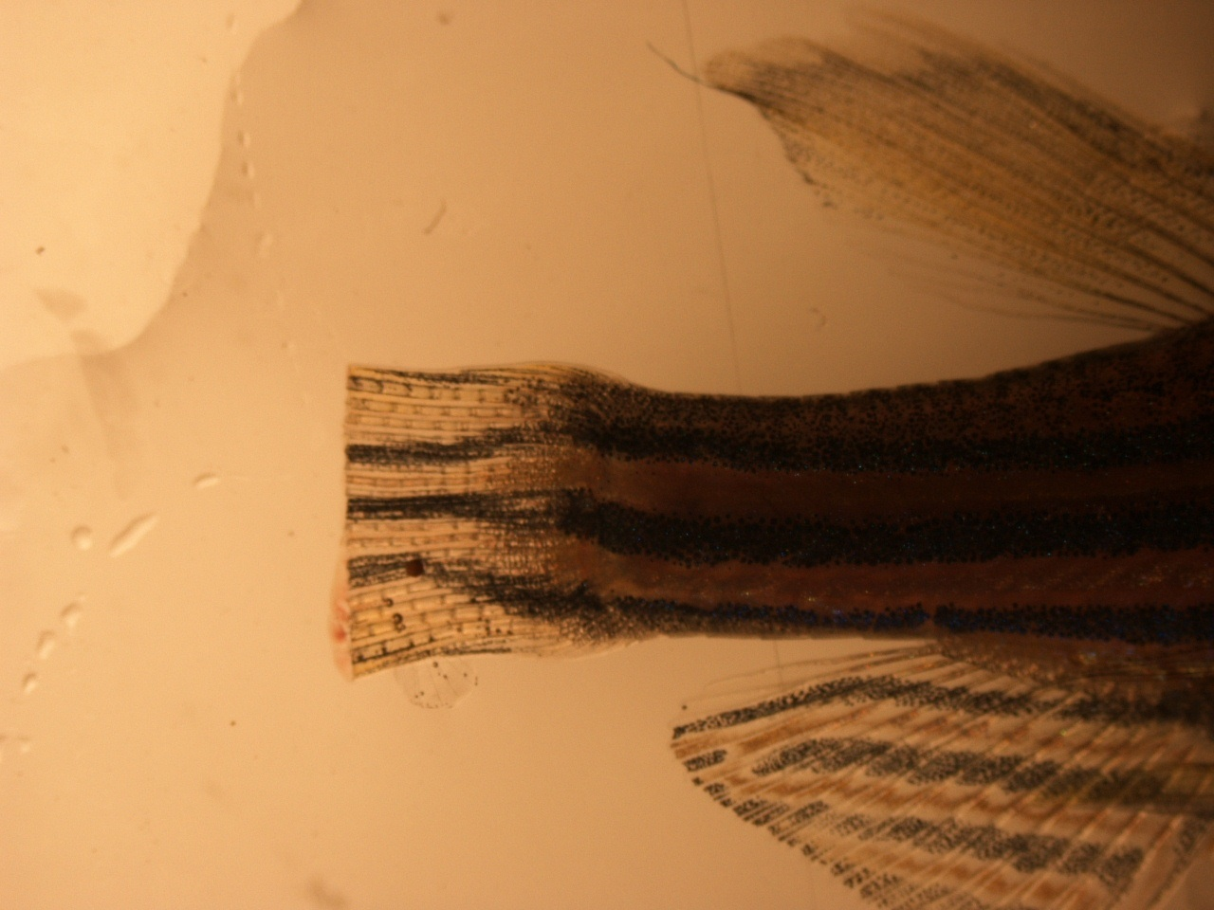
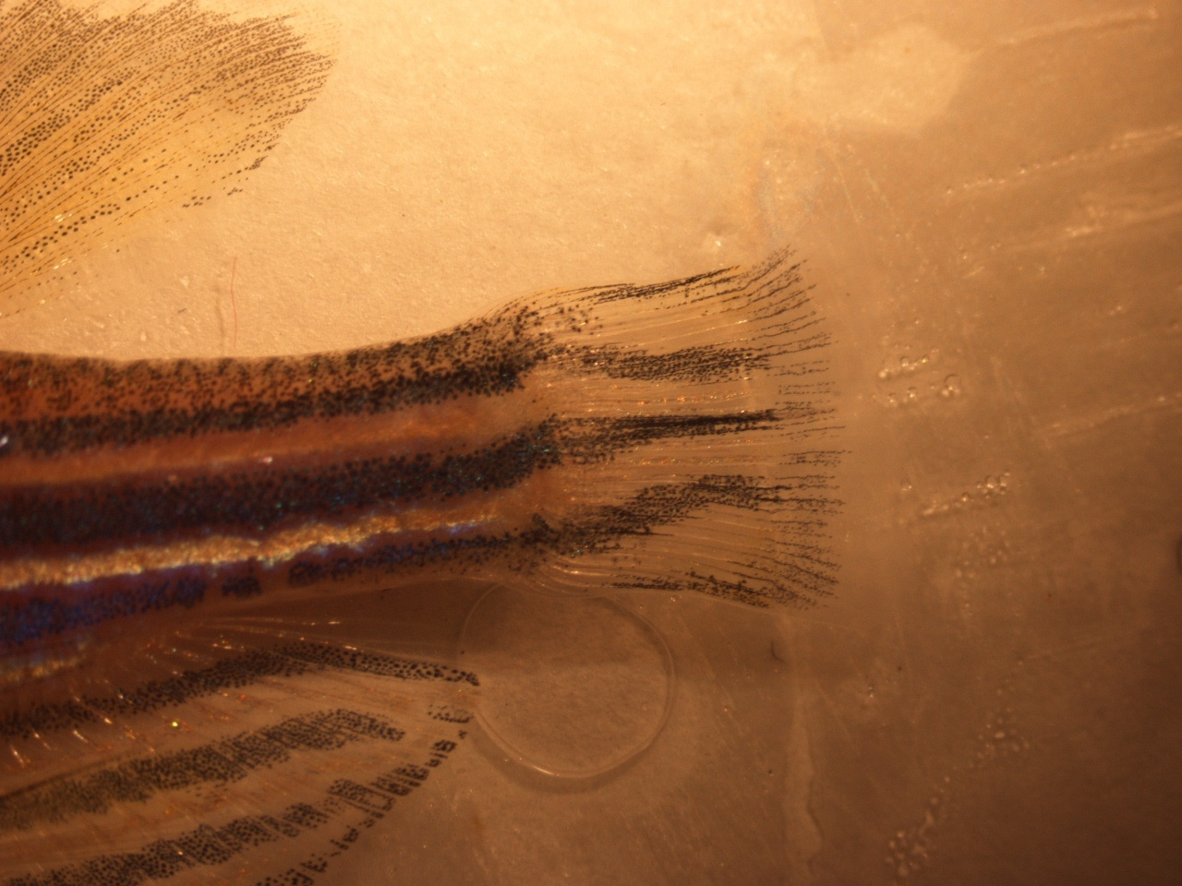
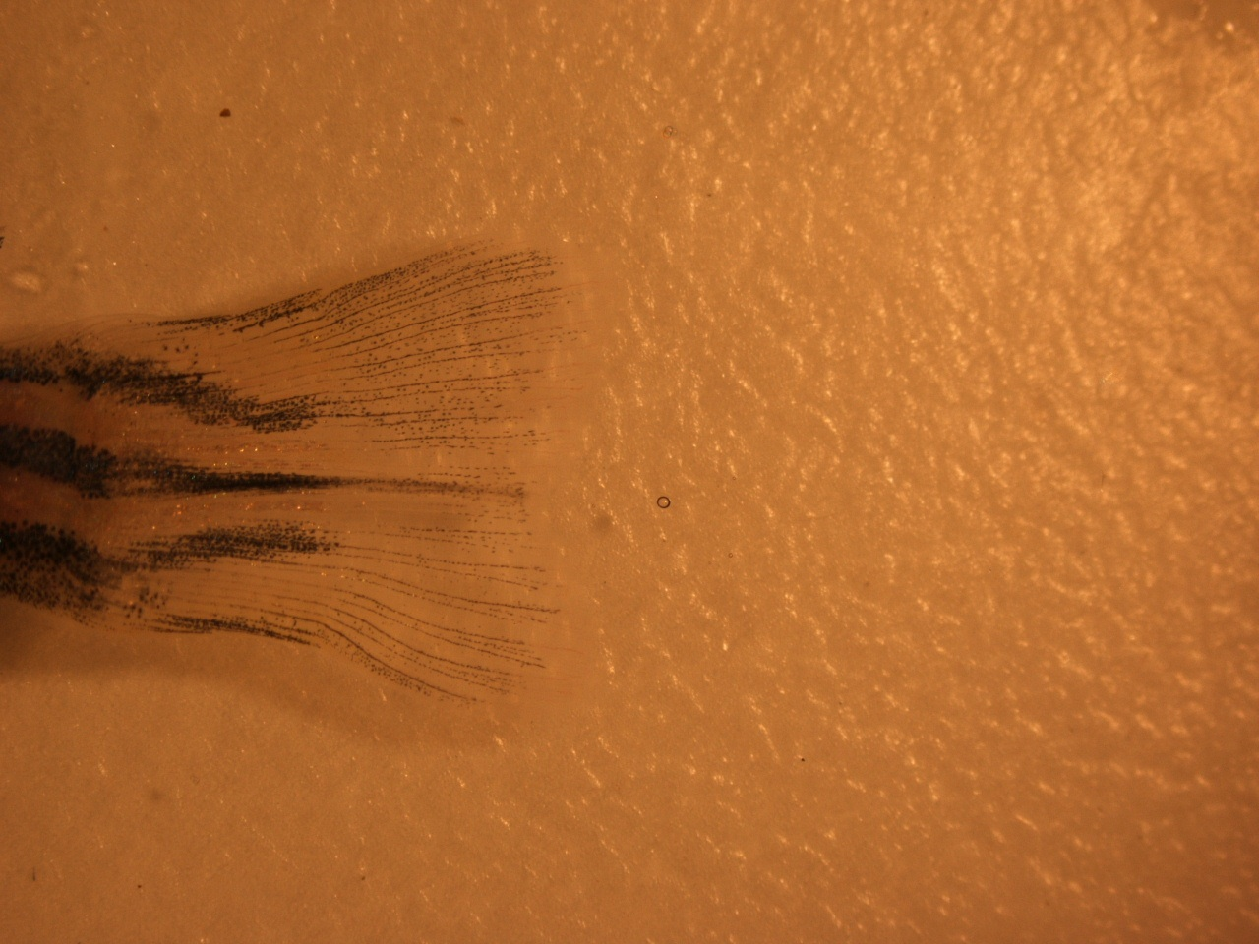
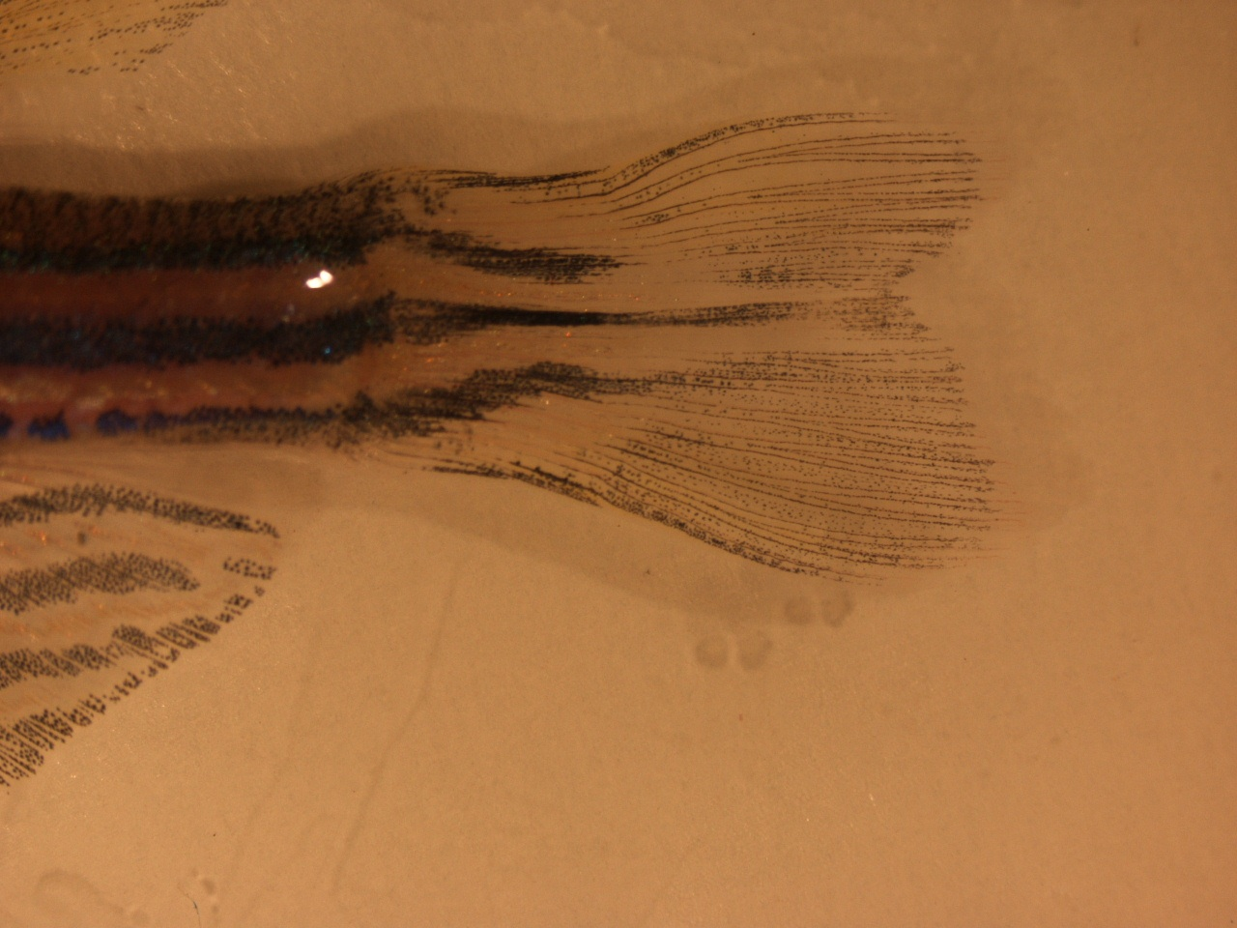
Results Long-Fin
A B C
D E
Figure 2- (A-B) are the caudal fin before and immediately after the cut. C is 7 days after the cut, D is 14 days after the cut, E is 21 days after the cut

Slide 12
Conclusion/Discussion
After three weeks the wild-type caudal fin had almost completely regenerated and the mutant had regenerated to about a third of its original length.
Researchers have concluded that complete regeneration occurs after a total of 30 day’s.
To get definitive results it would be conducive to continue the experiment for one or two more weeks to see if the long fin mutant regenerated to its original length.

Slide 13
Future research
The regenerative abilities in zebrafish are not completely understood.
Researchers are looking at the similarity gene expression between normal growth and regeneration to narrow down specific genes that could be regulating these growth patterns.
Scientist hope that figuring out these pathways will aid in human regeneration due to a high conservation of molecular interactions between different species.

Slide 14
References
Iovine, Kathryn, and Stephen Johnson. "Genetic Analysis of Isometric Growth Control Mechanisms in the Zebrafish Caudal Fin." Genetic Society of America 155 (2000): 1321-329. Print.

